Slide 1
GOVERNMENT COLLEGE OF ENGINEERING SRIRANGAM
DEPARTMENT OF ELECTRRONICS AND COMMUNICATION ENGINEERING
ARTIFICIAL INTELLIGENCE BASED RESUME ANALYZER
DOMAIN : ARTIFICIAL INTELLIGENCE
Presented by
S.HARIHARAN 830121106013
Y.M.KOHILA 830121106020
J.SABITHA SRI 830121106034
K.SENTHIL 830121106039
Under the Guidance of
Dr.R.RANJITH
ASSISTANT PROFESSOR
DEPARTMENT OF ELECTRONICS AND COMMUNICATION
ENGINEERING
GOVERNMENT COLLEGE OF ENGINEERING SRIRANGAM

Slide 2
ABSTRACT
The aim of this project is to design and develop a tool that results into an easy and helpful solution for applicants as well as recruiters.
“AI RESUME ANALYZER” which parses information from a resume using natural language processing, finds the keywords, cluster them onto sectors based on their keywords.
And lastly show the recommendation, prediction, analytics to the applicant / recruiter based on keyword matching.

Slide 3
PRESENT SYSTEM
Traditional hiring involved manual resume screening from newspaper ads and postal applications, making the process slow and inefficient. With industry growth, hiring consultancies emerged, requiring applicants to upload resumes in specific formats for structured data processing. However, the lack of standardization and time-consuming manual screening still pose challenges. To overcome these issues, an automated system is needed to parse, classify, and rank resumes efficiently.
LIMITATIONS:
This is no task for humans and time consuming.
It is challenging task to handle resume manually.
Clashes due to their own unique format.
Requires individual review of each resume from hiring managers.

Slide 4
PROPOSED SYSTEM
The proposed system “AI RESUME ANALYZER” is an applicant cum recruiter-based solution which can be widely used by any organization to analyze and get insights of a resume
The model uses natural language processing to understand the resume and then parse the information from it.
Once information is parsed it is stored in the database.
Quite productive for applicants because it gives predictions, tips and recommendations based on their resume information.
System works proper when the uploaded resume is in traditional chronological format.
Insightful for admin/recruiter due to its powerful analytics and informative data which is fetched from user/applicants resume

Slide 5
EVENT TABLE
The below event table shows types of events that can be used with our tool
EVENT | TRIGGER | SOURCE | USE CASE | RESPONSE | DESTINATION
User Want's to analyze his resume | Upload Resume | User | Analyze Resume | Analyzed Precdicted Result | User
User Want's to give feedback about this tool | New Feedback | User | Make a review | Review Analyzed History | User
Admin wants to view user's data, customer feedback and analytics | Login as Admin | Admin | view available user's data, customer feedback and show analytics | Data Table's and pie charts | Admin

Slide 6
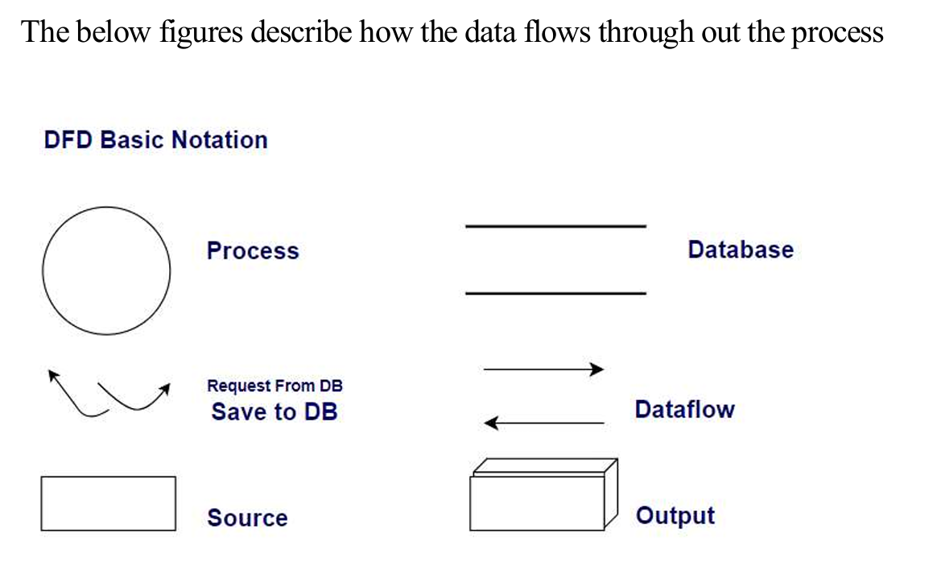
DATA FLOW DIAGRAM

Slide 7
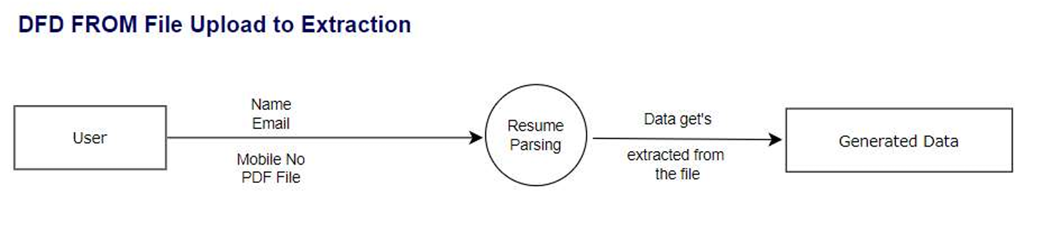
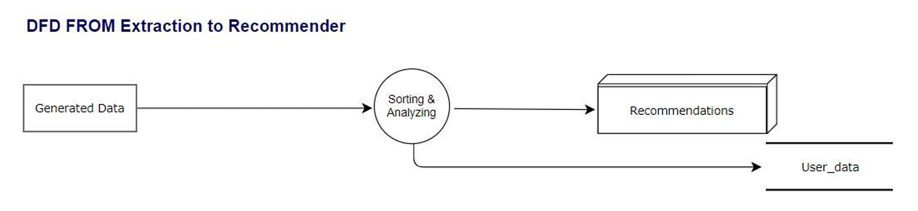

Slide 8
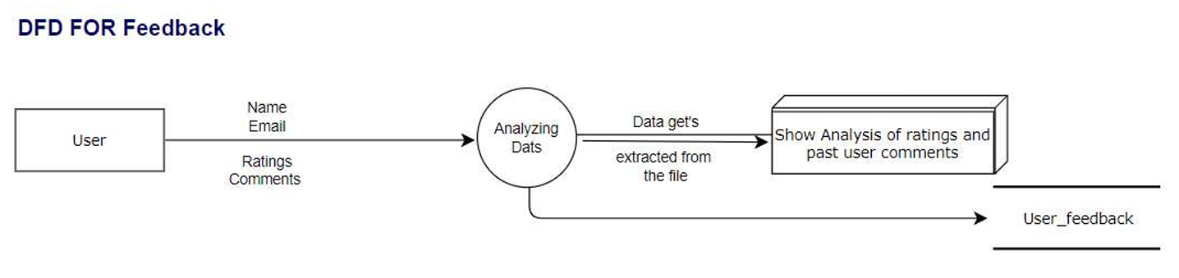
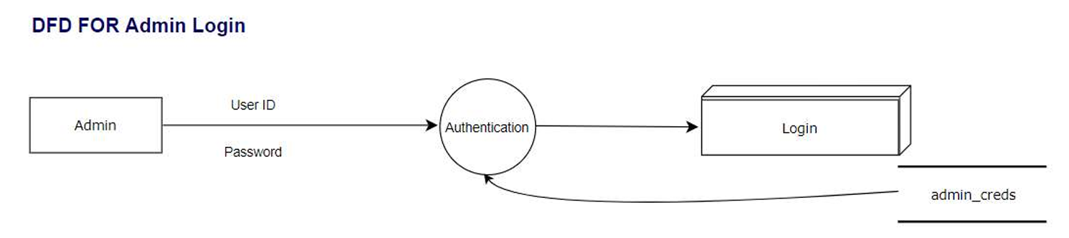

Slide 9
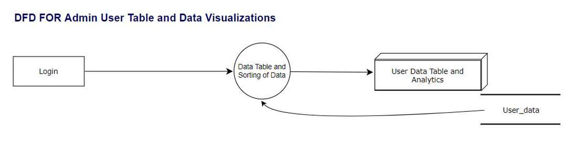

Slide 10
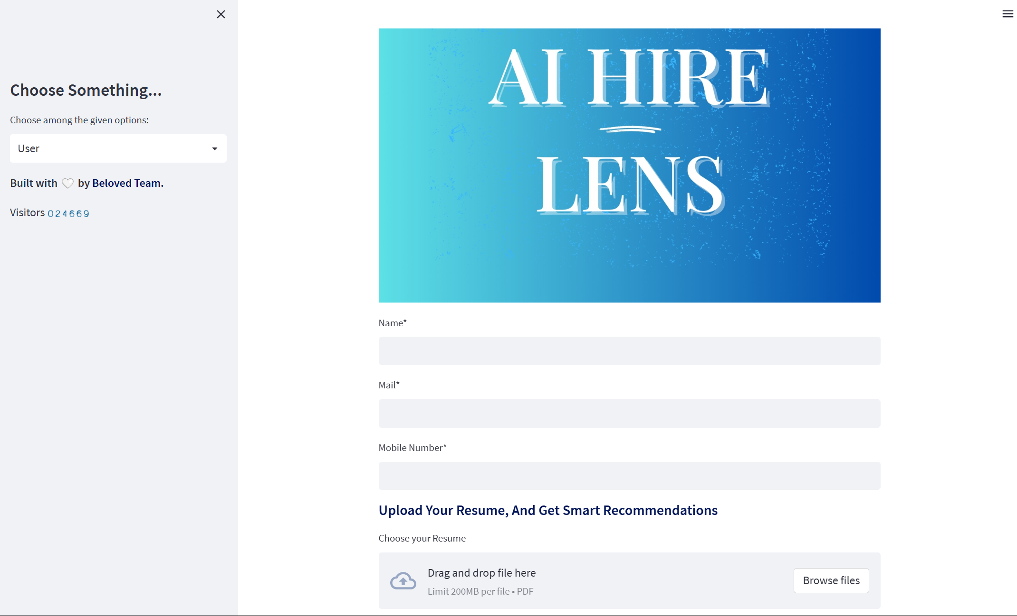
RESULTS
1.Home Page

Slide 11
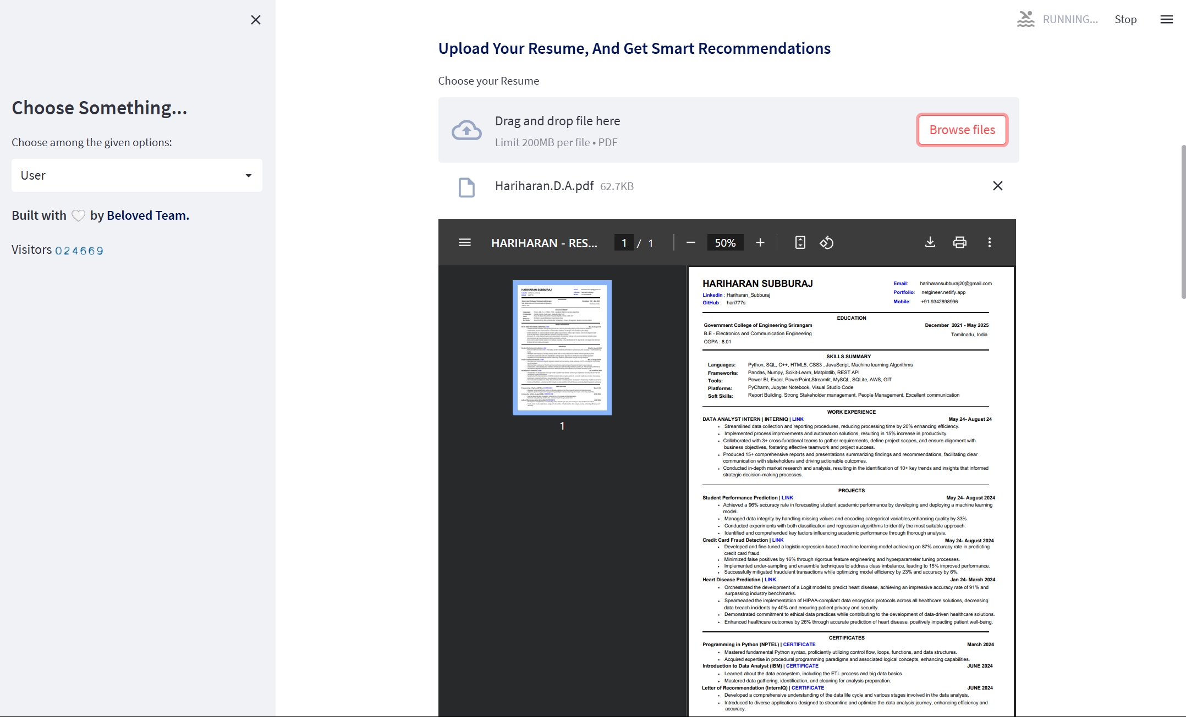
2.Upload and View resume

Slide 12
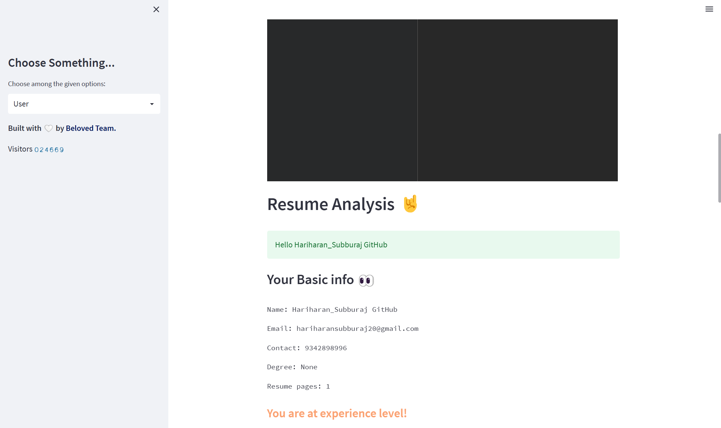
3. Analysis

Slide 13
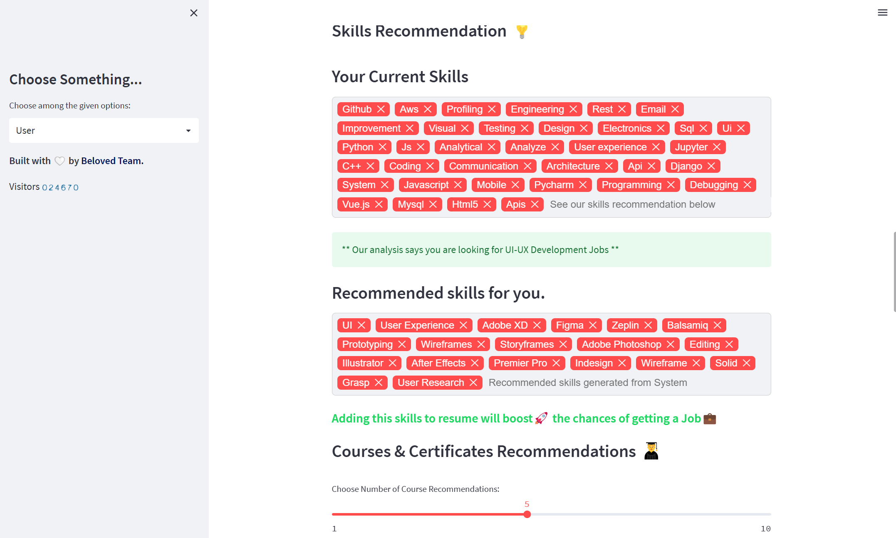
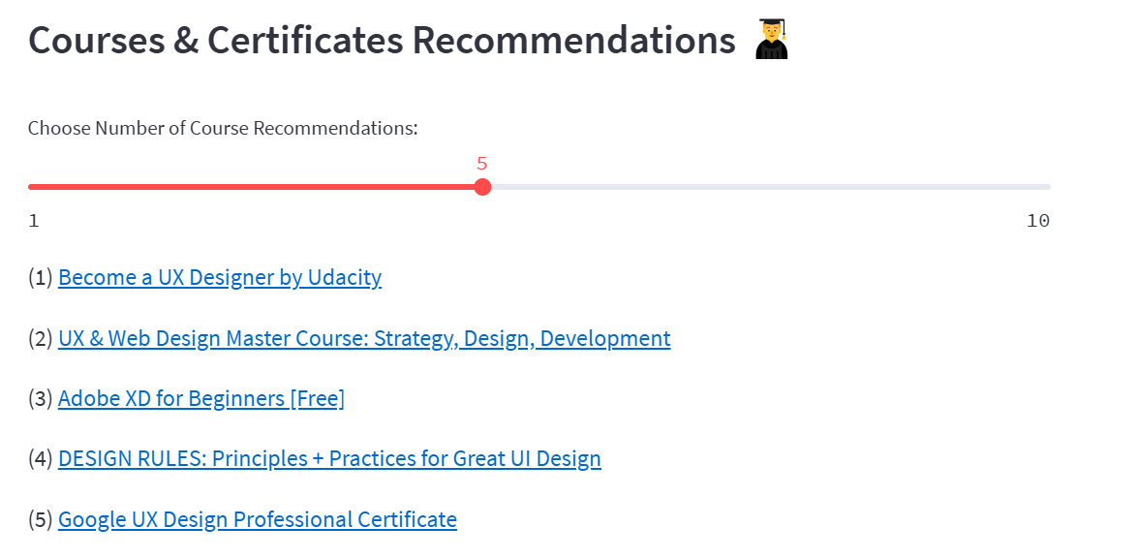
3. Recommendation & Prediction

Slide 14
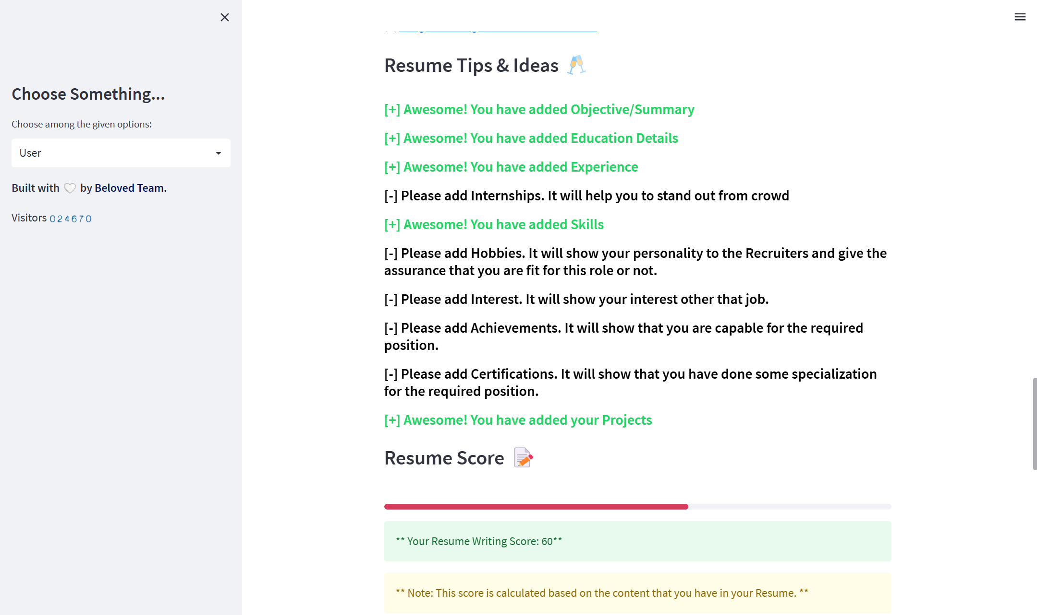
5. Resume tips & ideas with overall Scorer

Slide 15


6.Bonus tips for resume writing and interview tips

Slide 16
FUTURE WORKS
Enhance the system by including additional roles and their respective recommendations. Implement functionality to rank resumes based on a scoring system, allowing detailed analysis of individual user profiles. This will support more accurate and informed decision-making regarding job offers for candidates.

Slide 17
REFERENCE
https://docs.streamlit.io/
https://www.udemy.com/course/the-full-stack-data-scientist-bootcamp/
https://www.ijitee.org/wp-content/uploads/papers/v9i7/F4078049620.pdf https://www.academia.edu/32543544/Resume_Parser_with_Natural_Language_Processing https://www.rchilli.com/blog/resume-parsing-101/ https://en.wikipedia.org/wiki/R%C3%A9sum%C3%A9_parsing

